Slide 1
Balanced scorecard slide 1
EXECUTIVE SUMMARY
Airline Safety Analysis: SkyAir Airlines

Slide 2
Executive Summary- TouchpOINTS
Media Aspects
Airline Revenue
Costing Pressure
Recommendation
Legal and ethical considerations
References
Is Airline is as unsafe as reported by Media. Let’s review some data
Airline Industry is been high revenue generating industry. Has anything impacted
What are the drivers for cost and how can it be improved
Conclusion from the data
Data Authenticity & PII Disclaimers
Data Sources
the industry recently?

Slide 3
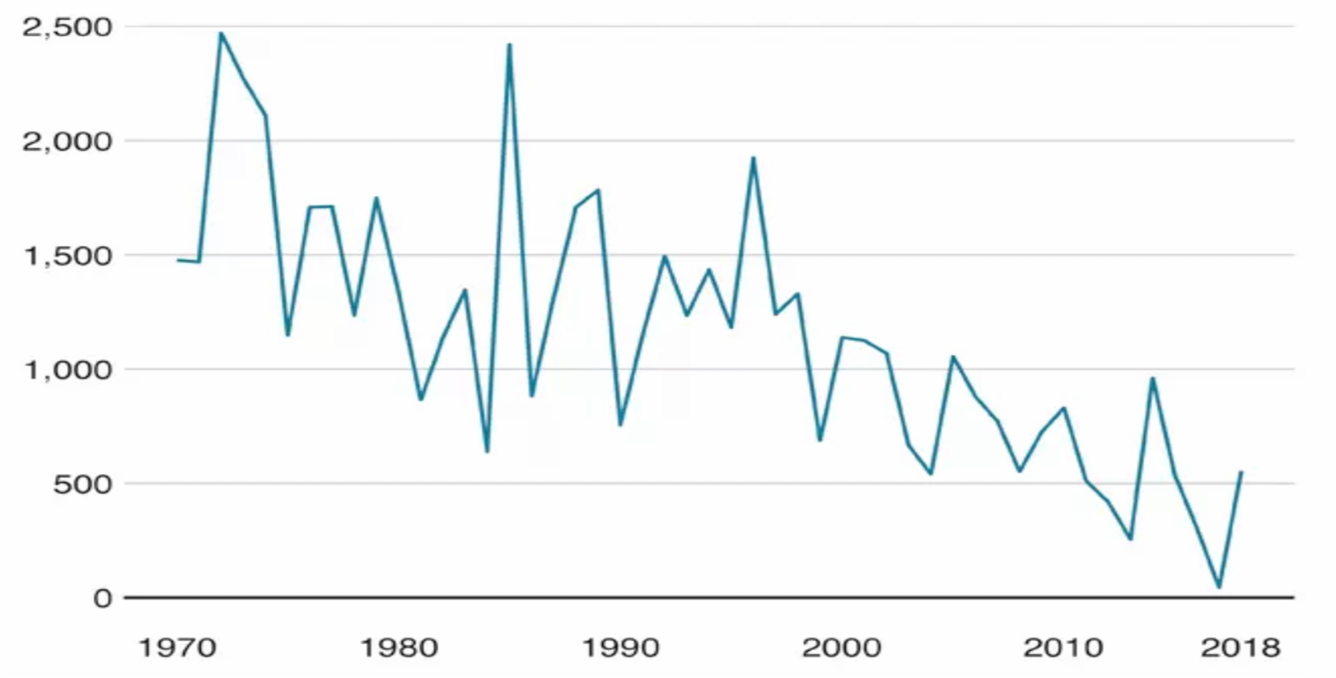
Media Aspects
Media reported sharp rise in airline accidents in 2018 as compared to previous years
Is it really a big number?
Let’s go though next slides to assess how safe is airline travel

Slide 4
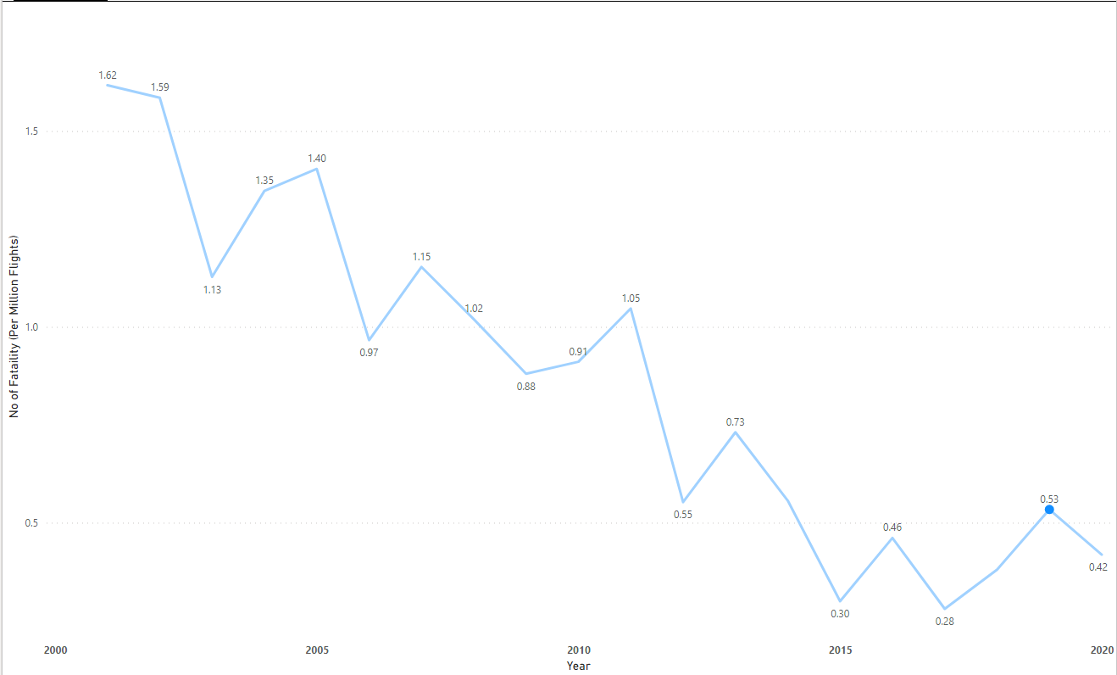
Trends in Data-Aviation
Only 0.59 Fatality occurred / Million of scheduled flights in 2019
What other options traveler can consider?
Review Road travel data in next slide

Slide 5
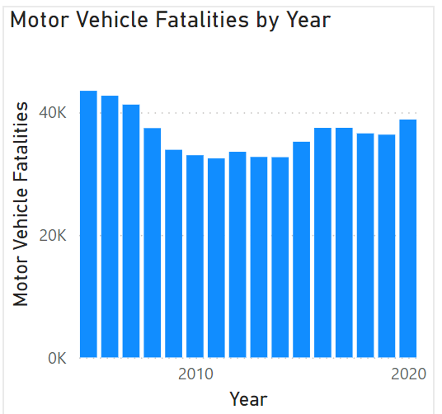
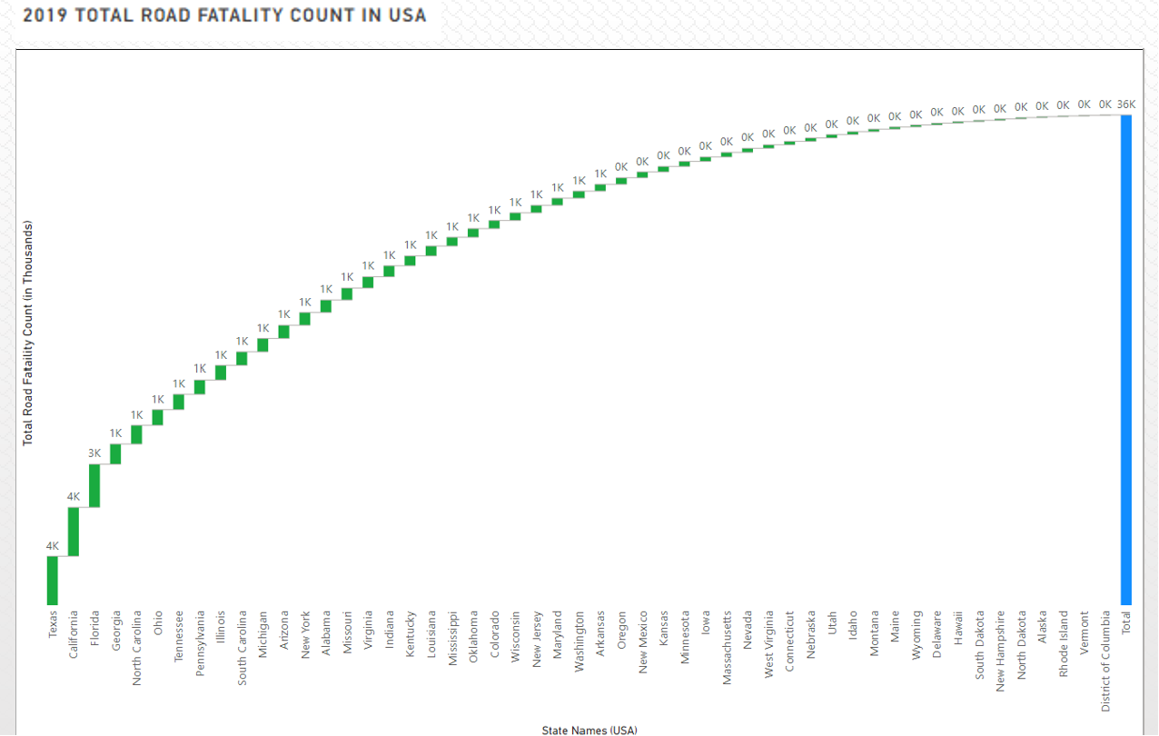
Road Travel- Data Understanding
Total Reported Road travel Fatality in 2019 was 36k
This number is way higher and not at all comparable to Airline fatalities numbers

Slide 6
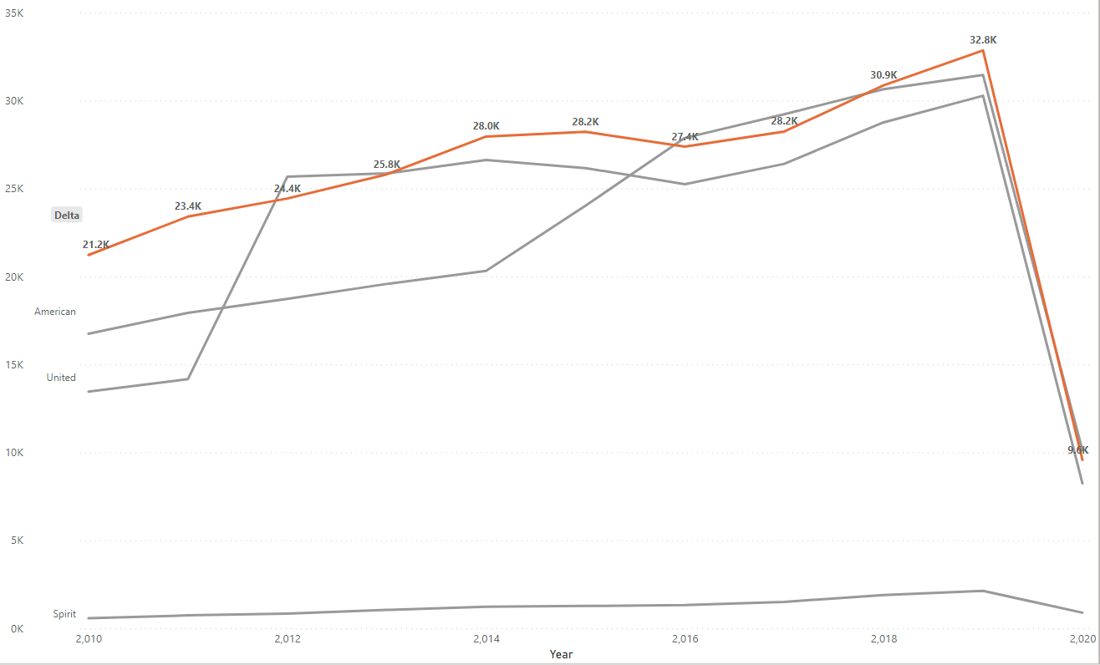
Airline Revenue
During Last Decade Delta was one of the consistently growing Airlines in terms of Revenue.
During 2020, due to International travel restrictions, all Airline company’s revenue declined to a decade low.

Slide 7
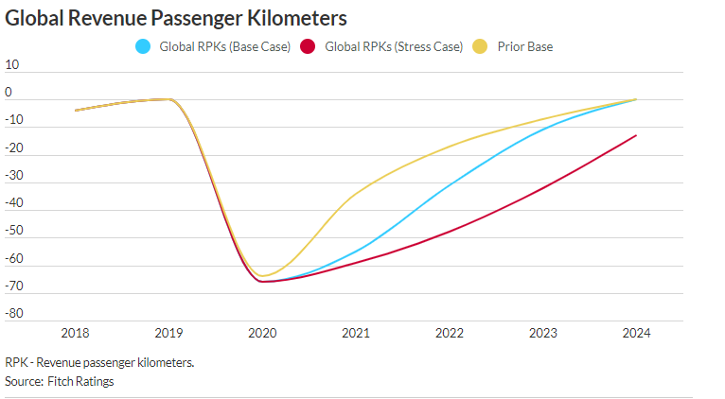
Airline Revenue
During 2020, due to airline travel restrictions all airline companies revenue declined to decade low
GRPK picked up in 2021 since all the travel ban was removed
Management Need to plan for upsizing the fleet capacity

Slide 8
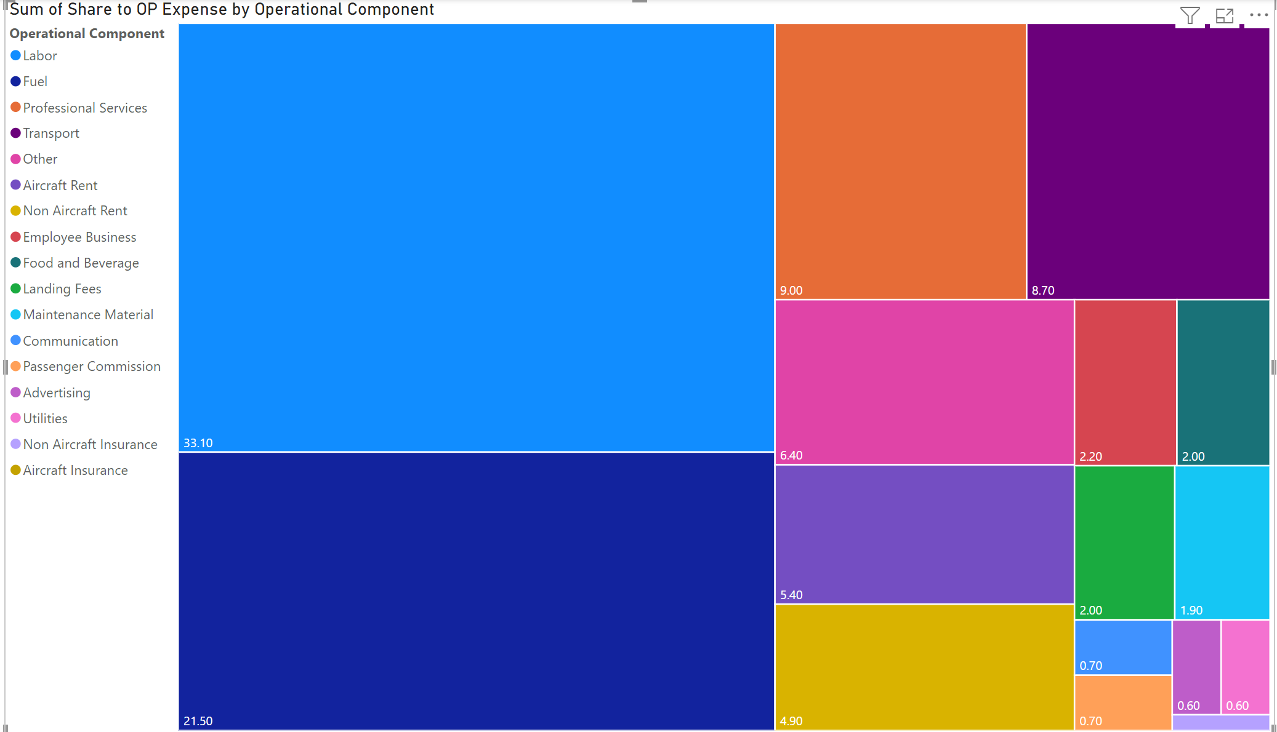
Costing Pressure
Post Covid, Inflation is Impacting Airline Operating Cost
Chart Showing the Updated Operational Components cost in percentage for Q4-2023
Management need to focus on controlling Operation cost by promoting more automation in operations

Slide 9
Conclusion
Airline reported Fatality (worldwide) was way less & not comparable than the total ground fatality reported alone in the USA
Management need to focus on controlling Operation cost by promoting more automation in operations
Management Need to plan for upsizing the fleet capacity

Slide 10
References and Legal/Ethical Aspects
Legal/Ethical
During our Analysis we haven’t used any PII data
All Data Sets are extracted from Public Websites.
Used Datasets have no restrictions for Academic usage
All used Datasets are Shared by respective government bodies for public benefits
We have listed the data source details with respectively associated graphs in each slide
References
https://docs.google.com/spreadsheets/d/1SDp7p1y6m7N5xD5_fpOkYOrJvd68V7iy6etXy2cetb8/edit?gid=1448957446#gid=1448957446
https://www.nhtsa.gov/data
http://web.mit.edu/airlinedata/www/2020%2012%20Month%20Documents/Traffic%20and%20Capacity/System%20Total/Passenger%20Revenue%20--%20Total%20System%20Operations.htm
https://www.airlines.org/dataset/a4a-quarterly-passenger-airline-cost-index-u-s-passenger-airlines/

